Slide 1


ReSave AI Platform
Cutting Food Waste Through Intelligent Prediction & Redistribution
The Hackvoks VIBEAITHON 2025

Slide 2

The Problem
Daily Waste Crisis
NGO Struggle
Tonnes of edible food wasted in hostels, hotels, and restaurants due to inaccurate demand estimation.
Shelters lack consistent donors, creating food scarcity for vulnerable communities.
Triple Impact
Institutions face financial loss, environmental damage (methane emissions), and ethical concerns.

Slide 3
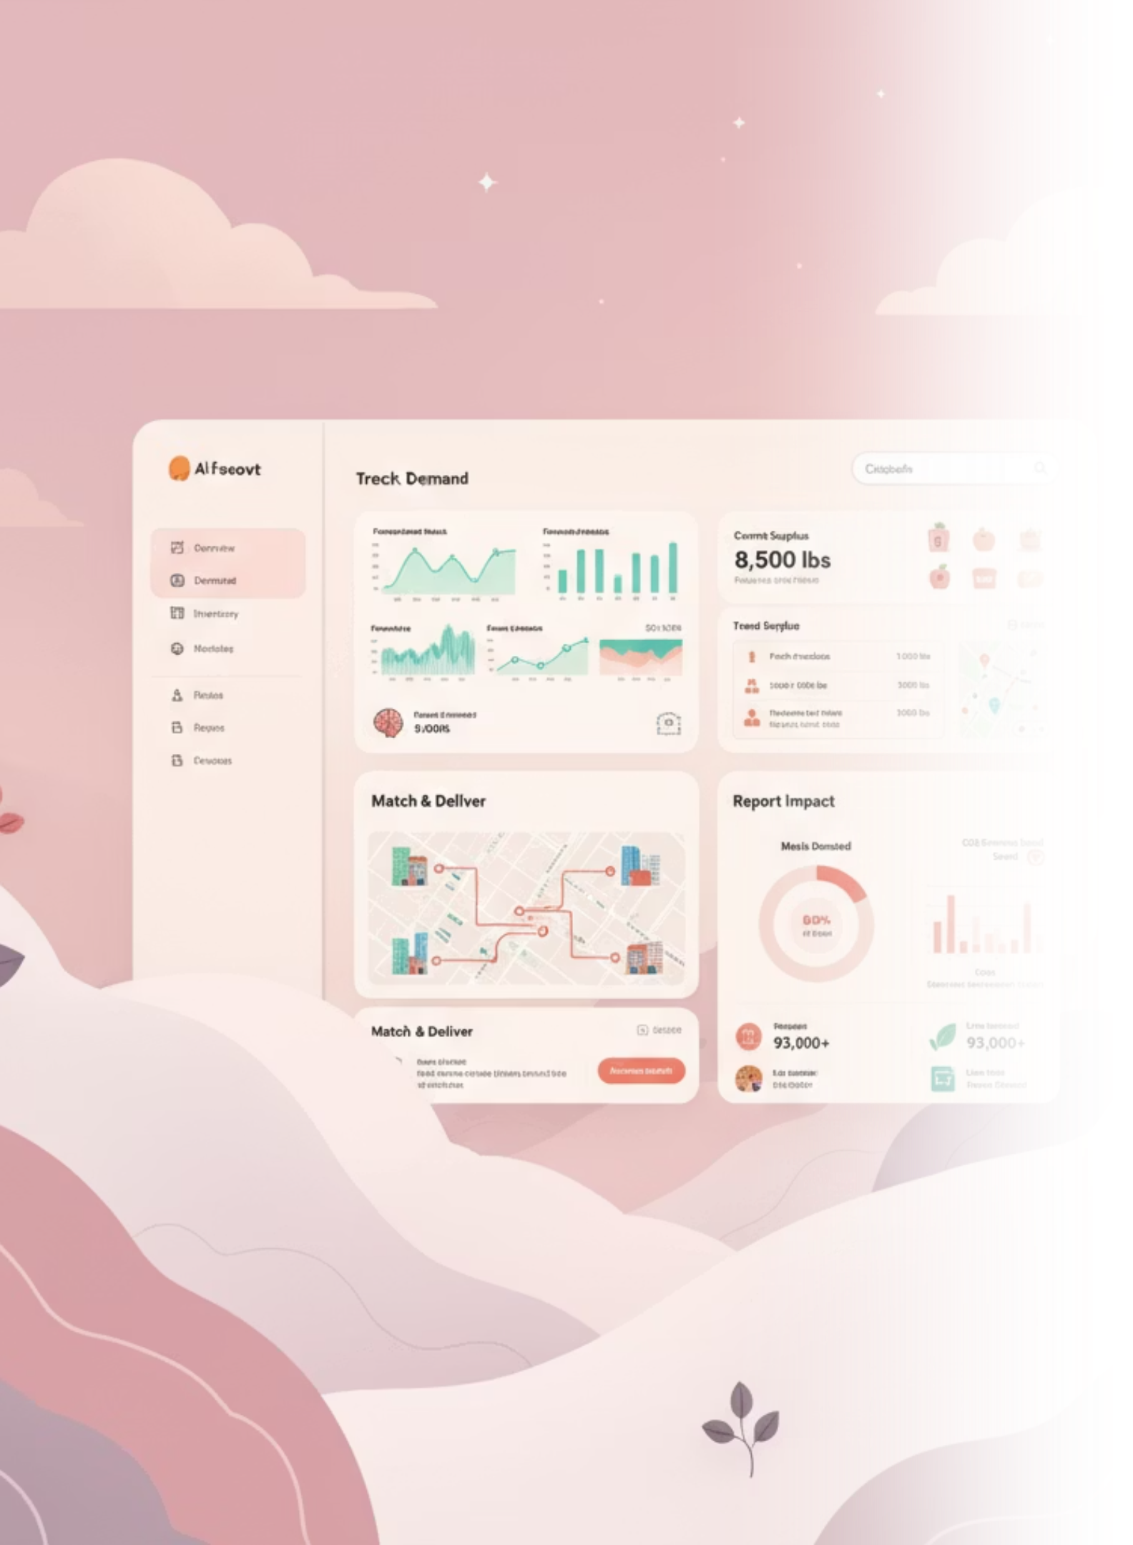
ReSave Solution
An AI-powered platform that predicts demand, prevents waste, and connects surplus food to NGOs in real time.
1
Predict Demand
Machine learning forecasting reduces waste by 20–30%.
2
Track Surplus
Real-time dashboard monitors available food inventory.
3
Match & Deliver
Automated NGO matching with pickup coordination.
4
Report Impact
CSR & sustainability reports for donors.

Slide 4

User Validation
Hotels & Institutions
NGOs & Shelters
90% of surveyed hotels need real-time food waste monitoring.
Confirmed benefit of predictable, reliable donation timing.
Pain points: overproduction costs, inefficient tracking.
Solves: food scarcity, supply inconsistency.

Slide 5
Technology Stack
Frontend
Backend
Integration
HTML5 + Tailwind CSS + Vanilla JavaScript + Chart.js
Node.js / Flask + Express with PostgreSQL database
Google Maps API for NGO location & routing
Hosting
AWS / Firebase for scalable deployment

Slide 6
Development Roadmap
Now (MVP)
1
AI prediction, surplus tracking, NGO matching
2
30 Days
Live donation data integration, real-time alerts
60 Days
3
CSR dashboards & role-based login system
4
90 Days
Pilot deployment in 5 hotels + 3 NGO networks
Future
5
IoT smart bins + blockchain tracking

Slide 7

Impact & Scalability
25-30%
15-20%
1000+
Waste Reduction
Cost Savings
Meals Monthly
Decrease in food waste per institution
Reduction in food procurement expenses
Donated per partner site
Scalability: SaaS model, partnerships with food delivery platforms (Zomato, Swiggy), expansion to city-level networks.

Slide 8


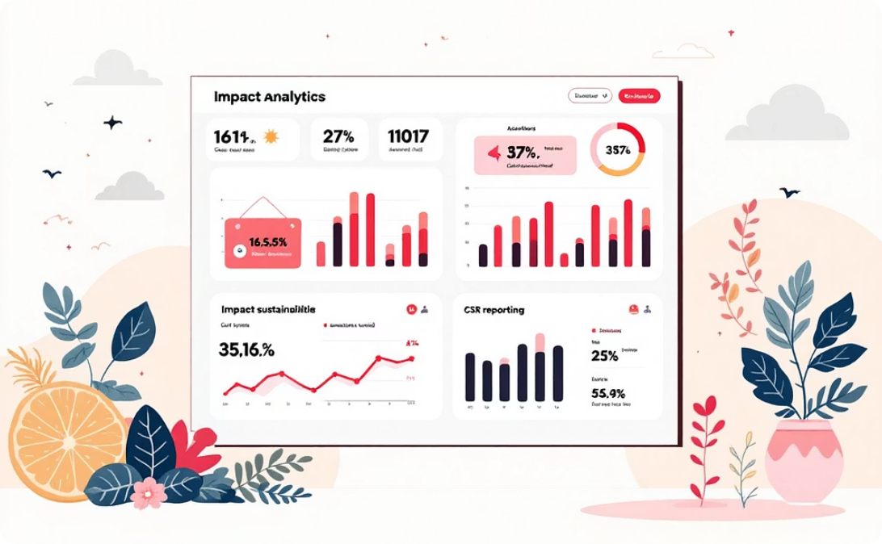
Prototype Features
AI Prediction Dashboard
NGO Matching Panel
Impact Analytics
Real-time demand forecasting with Chart.js visualization.
Automated matching with auto-routing to nearest shelters.
CO₂ avoided, meals saved, cost reduction tracking.

Slide 9
Team & Expertise
Role
Team Member
Expertise
Focus
Frontend Designer
Abinaya A
React, Tailwind CSS
User interface
Quality Assurance (QA) Engineer / Tester
Bushra Jabeen I
Testing, Debugging, Automation Tools
Application reliability & bug detection
Security & API Integration Engineer
Divya E
OAuth, JWT, API Security, Google Maps API
Implement secure authentication and integrate third-party APIs like Google Maps.
Full Stack Developer
Janani A
Python, React, Node.js, AI/ML
End-to-end development & architecture
Data Engineer
Pooja S
TensorFlow, PostgreSQL
ML model training
Why Us: Combined expertise in AI, web development, hackathons, and sustainability tech with proven analytics capabilities.

Slide 10
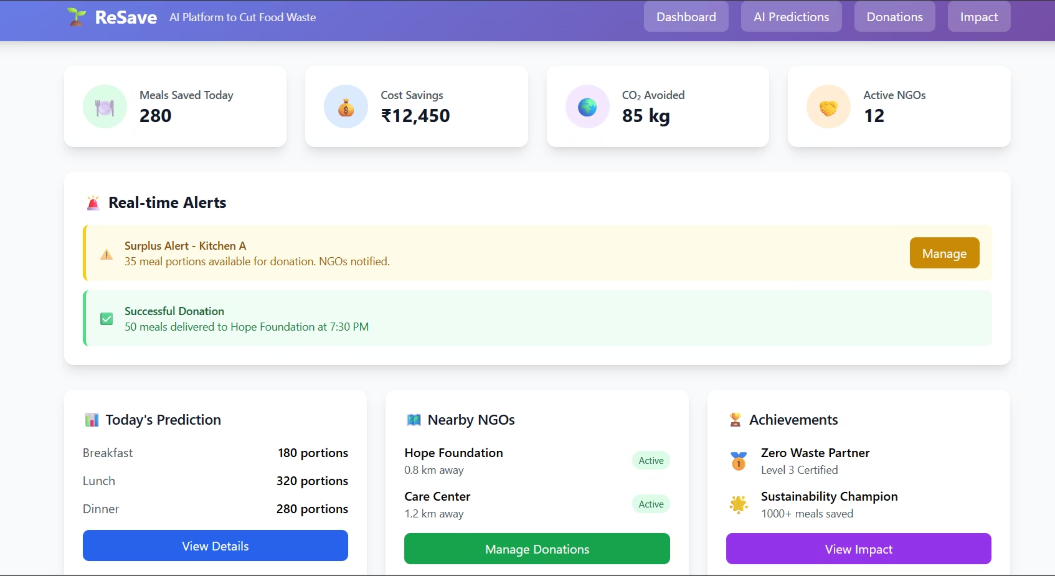
Our Resave AI

Slide 11
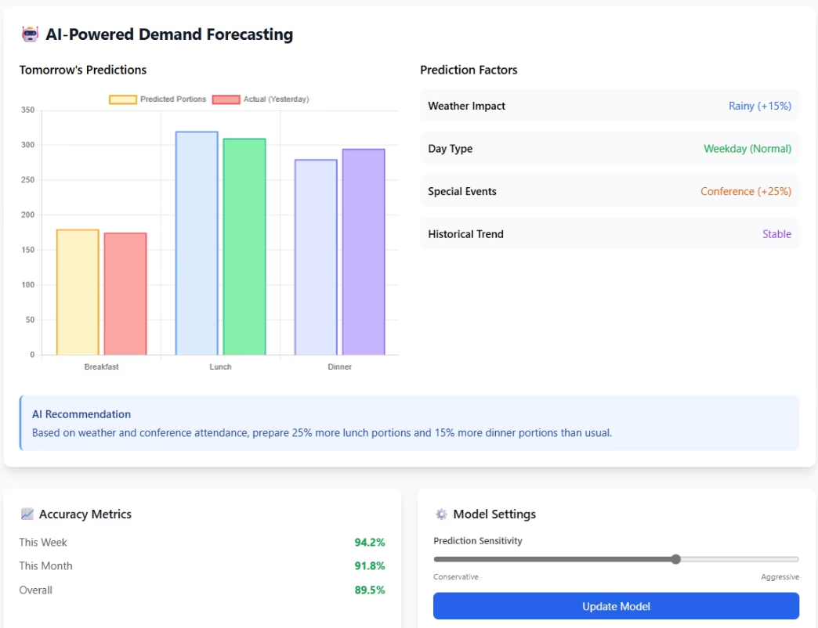
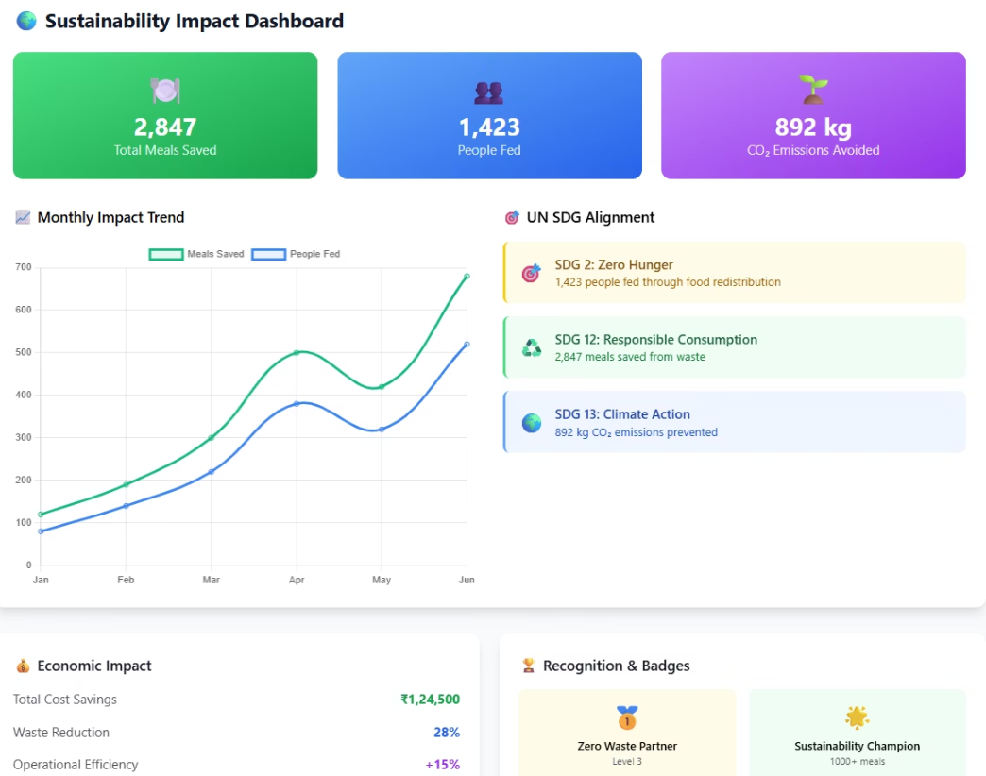
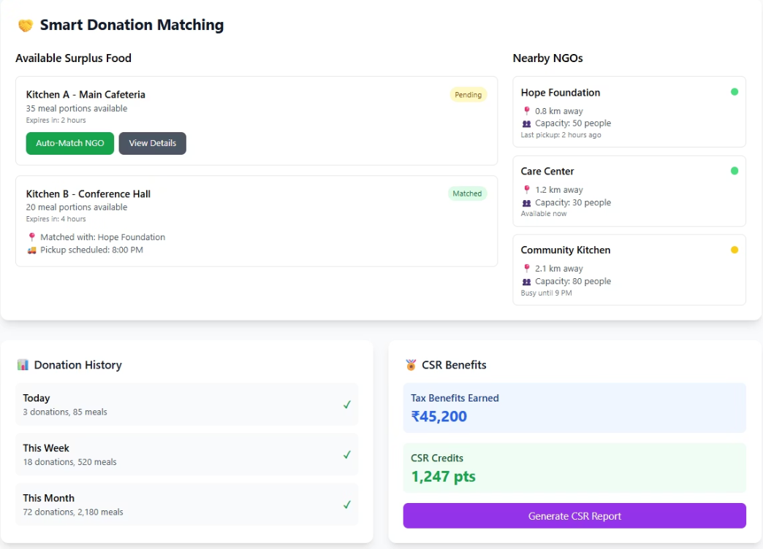

Slide 12



Our Ask & Vision
Mentorship
Partnerships
Support
Scaling AI & IoT integration expertise
NGOs, hotels, government bodies
Cloud credits & incubation for pilot
Predict. Prevent. Preserve.
Turning Tomorrow's Trash into Today's Treasure
Contact: divyaes26@gmail.com | LinkedIn | GitHub

